Slide 1
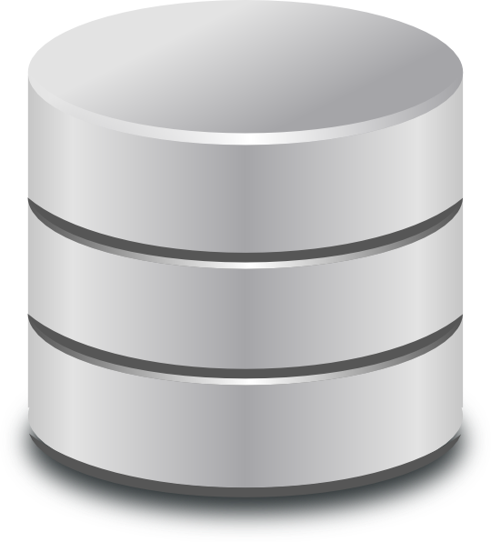

Introduction to Database Systems
Fall 2024
Lecture - 1

Slide 2

Course Motivation
Databases are used in building many software systems like
banking systems,
video games,
or dynamic websites
Databases are so important that computer science graduates frequently refer to their database class as the one most useful to them in their other courses and careers.

Slide 3

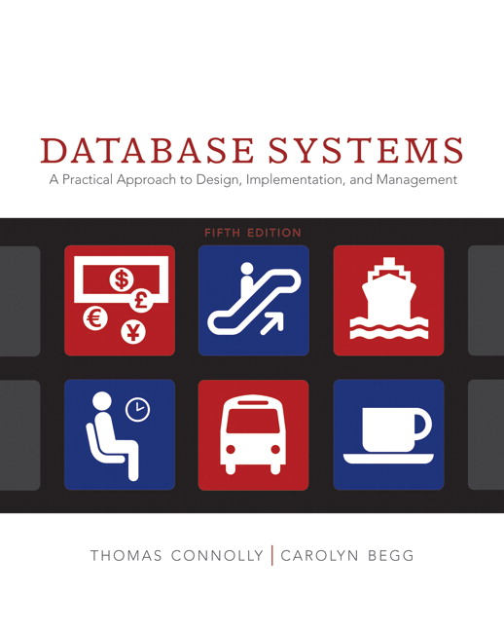
Literature
The primary text book for the course is
“Database Systems, A practical approach to design, implementation and management”
Sixth Edition
Thomas Connolly, Carolyn Begg, Addison Wesley

Slide 4

What is Database?
Chapter – 1 (Introduction to database)

Slide 5
Definition
A database is a shared collection of logically related data that is stored to meet the requirements of different users of an organization

Slide 6

The Concept of Shared Organizational Database
Registration
Attendance
Database
Exam
Accounts
Admission
University Management System

Slide 7
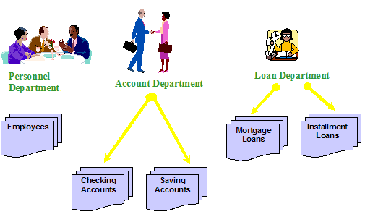
A brief History File Based Systems
A collection of application programs that perform services for the system end-users such as the production of reports. Each program defines and manages its own data.

Slide 8
File Based Systems
Registration
Data Files
Attendance
Data Files
Exam
Data Files
Data Files
Accounts
Admission
Data Files
University Management System

Slide 9
File Based Systems Limitations
Account |  | Exam |  | Registration
Reg_Number |  | Reg_Number |  | Reg_Number
Name |  | Name |  | Name
Father Name |  | Address |  | Father Name
Fee |  | Class |  | Phone
Fine |  | Semester |  | Address
Address |  | Grade |  | Class
Separation and isolation of data (more than two files)
Duplication of data
Data dependence (Applications)
Incompatible file formats (Programming Lang.)
Fixed queries of application programs

Slide 10
Database Approach Advantages
Registration
Attendance
Database
Exam
DBMS
Accounts
Admission
University Management System

Slide 11
Database Advantages
Data sharing
Reduced Redundancy (Duplication)
Data independent (Self description of data)
Data Integrity (Correctness)

Slide 12
Database Management System DBMS
A software system that enables users to define, create, maintain, and control access to the database.
The DBMS is the software that interacts with the users application programs and the database.

Slide 13
Application Program
A computer program that interacts with the database by issuing an appropriate request (typically an SQL statement) to the DBMS.

Slide 14
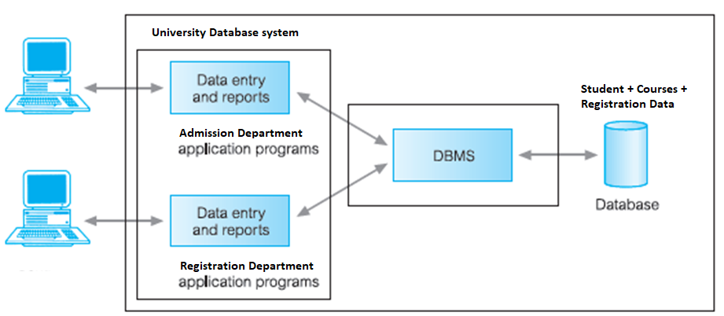
Data Flow

Slide 15
DBMS Services
DBMS allows users to define the database, usually through a Data Definition Language (DDL) which specify the data types, structures and the constraints on the data to be stored in the database.
Example:
Student Name should be of type char of length 100.
GPA value must be greater than 2.0 to pass the semester

Slide 16
DBMS Services
DBMS allows users to insert, update, delete, and retrieve data from the database, usually through a Data Manipulation Language(DML).
Structured Query Language (SQL, pronounced ‘S-Q-L’, or sometimes ‘See-Quel’) standard for Relational DBMS.
Give the student names whose CGPA is greater than 3.0 (Select)
Insert new Student information like Name, Age, Father Name, Program, etc (Insert)
Delete the record of student having Reg# BC123456 (Delete)
Update the Address of Student whose mobile number was 033312345678 (Update)

Slide 17
DBMS Services
DBMS provides controlled access to the database
A security system
An integrity system
A concurrency control system
A recovery control system
A user-accessible catalog

Slide 18
DBMS Services
Data Processing
A DBMS must provide users with the ability to store, retrieve, and update data in the database.
DBMS should hide the internal physical implementation details (such as file organization and storage structures) from the user.
A user accessible Catalog
A DBMS must provide a catalog in which descriptions of data items are stored and which is accessible to users.
Transaction Support
A DBMS must provide a mechanism which will ensure either that all the updates corresponding to a given transaction are made or that none of them is made.

Slide 19
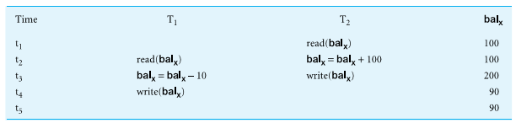
DBMS Services
Concurrency Control Services
A DBMS must provide a mechanism to ensure that the database is updated correctly when multiple users are updating the database concurrently.

Slide 20
DBMS Services
Recovery services
A DBMS must provide a mechanism for recovering the database in the event that the database is damaged in any way
Authorization services
A DBMS must provide a mechanism to ensure that only authorized users can access the database.
Support for data communication
A DBMS must be capable of integrating with communication software.
Data Communication Manager (DCM)
Integrity services
Database integrity refers to the correctness and consistency of stored data

Slide 21
View
Allows each user to have his or her own view of the database.
A view is essentially some subset of the database.

Slide 22
View Benefit
Provide a level of security
Provide a mechanism to customize the appearance of the database
Present a consistent, unchanging picture of the structure of the database, even if the underlying database is changed

Slide 23
Roles in Database Environment
Data Administrator (DA)
The Data Administrator is responsible for defining data elements, data names and their relationship.
Database Administrator (DBA)
The basic role of a Database Administrator is to store and manage the information in the database.
The different functionalities of a database administrator are maintaining database system software, developing physical database structures and data dictionary.
Database Designers (Logical and Physical)
Application Programmers
End Users
Notes:
Database Administrator: The basic role of a Database Administrator is to store and manage the information in the database. They are responsible for reviewing the contents in the database. They are performing all the activities related to maintaining the database and responsible for designing, implementing the database. Also their responsible is to backed up data regularly and prevent from unauthorized access. They are also known as Database Coordinator or Database Programmer. The different functionalities of a database administrator are maintaining database system software, developing physical database structures and data dictionary. Data Administrator: The Data Administrator is responsible for defining data elements, data names and their relationship with the database analyst. The basic responsible is how to install and configure the RDBMS applications and also they have to know the requirements of the software application in terms of functions and assure the data integrity. They are also known as Data Analyst. Following are some basic steps for a Data Administrator, • Specification of organization data. • The design and maintenance of data management application. • Validating the data and files. • Security of files or databases.

Slide 24
Advantages of DBMS
Control of data redundancy
Data consistency
More information from the same amount of data
Sharing of data
Improved data integrity
Improved security
Improved maintenance through data independence
Improved backup and recovery services

Slide 25
Disadvantages of DBMS
Complexity
Size
Cost of DBMS
Additional hardware costs
Cost of conversion
Performance
Higher impact of a failure

Slide 26
History
First-generation
Hierarchical and Network
Second generation
Relational
Third generation
Object-Relational
Object-Oriented

Slide 27
Thank You

